Slide 1

Northeastern University - Seattle
CS6650 Building Scalable Distributed Systems
Vishal Rajpal

Slide 2
Week 6 – Asynchronous Systems
Topics we will cover today:
Asynchronous Systems Basics
Example: RabbitMQ
Messaging Patterns
Case Study
Notes:
Communication is vital for distributed systems.
So far our discussions have assumed a synchronous messaging style i.e. A client sends a request and waits for a server to respond. Most distributed communications are designed to happen synchronously as client requires a response to proceed.
However, not all systems have this requirement.

Slide 3
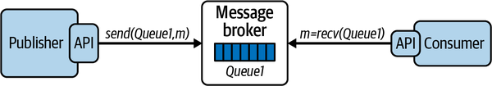
Asynchronous Systems Basics
Messaging Primitives
Message queues: Queues that store a sequence of messages
Producers- Send messages to queues
Consumers- Retrieve messages from queues
Message broker=Manages one or more queues

Slide 4
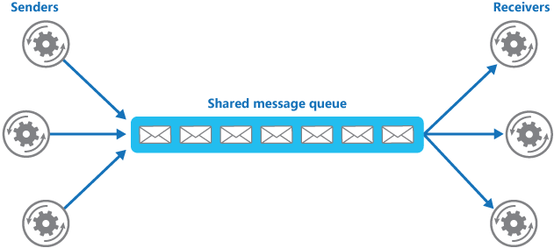
Asynchronous Systems Basics
Message Broker
Notes:
A message broker is a service that manages one or more queues.
When messages are sent from producers to a queue, the broker adds messages to the queue in the order they arrive—basically a FIFO approach.
The broker is responsible for efficiently managing message receipt and retention until one or more consumers retrieve the messages, which are then removed from the queue.
Message brokers that manage many queues and many requests can effectively utilize many vCPUs and memory to provide low latency accesses.
Many Consumers can takes messages from the same queue.
Each message is retrieved by exactly one consumer.
There are two modes of behavior for consumers to retrieve messages, known as pull or push. While the exact mechanisms are product-specific, the basic semantics are common across technologies:
In pull mode, also known as polling, consumers send a request to the broker, which responds with the next message available for processing. If there are no messages available, the consumer must poll the queue until messages arrive.
In push mode, a consumer informs the broker that it wishes to receive messages from a queue. The consumer provides a callback function that should be invoked when a message is available. The consumer then blocks (or does other work) and the message broker delivers messages to the callback function for processing when they are available.
Generally, utilizing the push mode when available is much more efficient and recommended. It avoids the broker being potentially swamped by requests from multiple consumers and makes it possible to implement message delivery more efficiently in the broker.

Slide 5


Asynchronous Systems Basics
Consumer Acknowledgement
Auto
Manual
4. processMessage()
2. ack
Consumer
1. deliver
3
2. processMessage()
3. ack
Consumer
1. deliver
4
Notes:
Consumers will also acknowledge message receipt.
Upon consumer acknowledgment, the broker is free to mark a message as delivered and remove it from the queue. Acknowledgment may be done automatically or manually.
If automatic acknowledgment is used, messages are acknowledged as soon as they are delivered to the consumer, and before they are processed. This provides the lowest latency message delivery as the acknowledgment can be sent back to the broker before the message is processed.
But what happens if the consumer crashes before the message is delivered?
Manual Ack guards against the possibility of a message being delivered to a consumer but not being processed due to a consumer crash.
It does, of course, increase message acknowledgment latency.
Regardless of the acknowledgment mode selected, unacknowledged messages effectively remain on the queue and will be delivered at some later time to another consumer for processing.

Slide 6
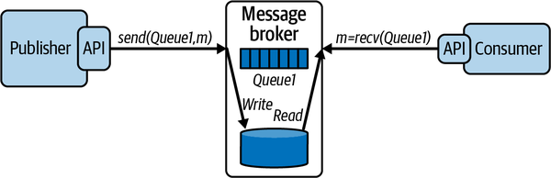
Asynchronous Systems Basics
Message Persistence
Message Queues are typically memory based
Notes:
By default, message queues are typically memory based, in order to provide the fastest possible service to producers and consumers. Managing queues in memory has minimal overheads, as long as memory is plentiful. It does, however, risk message loss if the server crashes.
To guard against message loss—a practice known as data safety—queues can be configured to be persistent. When a message is placed on a queue by a producer, the operation does not complete until the message is written to disk.
Now, if a message broker should fail, on reboot it can recover the queue contents to the state they existed in before the failure, and no messages will be lost. Many applications can’t afford to lose messages, and hence persistent queues are necessary to provide data safety and fault tolerance.

Slide 7
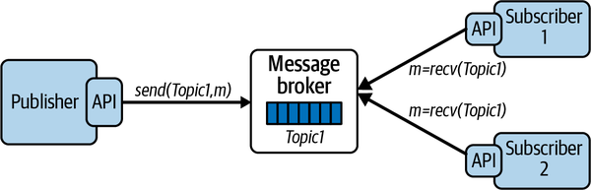
Asynchronous Systems Basics
Publish-Subscribe
Notes:
Message queues deliver each message to exactly one consumer. For many use cases, this is exactly what you want. But there can be use cases where more than one consumer needs that message.
In publish–subscribe systems, message queues are known as topics. A topic is basically a message queue that delivers each published message to one or more subscribers
With publish–subscribe, you can create highly flexible and dynamic systems.
Publishers are decoupled from subscribers, and the number of subscribers can vary dynamically.
This makes the architecture highly extensible as new subscribers can be added without any changes.
It also makes it possible to perform message processing by a number of consumers in parallel, thus enhancing performance.
Publish–subscribe does place additional performance burden on the broker.
The broker is obliged to deliver each message to all active subscribers.
As subscribers will inevitably process and acknowledge messages at different times, the broker needs to keep messages available until all subscribers have consumed each message.

Slide 8
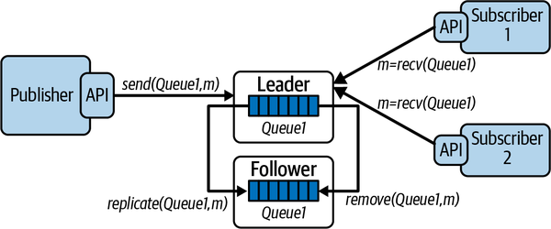
Asynchronous Systems Basics
Message Replication
Notes:
The message broker is potentially a single point of failure.
A system or network failure can cause the broker to be unavailable, making it impossible for the systems to operate. This is rarely a desirable situation.
For this reason, most message brokers enable logical queues and topics to be physically replicated across multiple brokers, each running on their own node.
If one broker fails, then producers and consumers can continue to process messages using one of the replicas.
Messages published to the leader are mirrored to the follower, and messages consumed from the leader are removed from the follower.
With leader-follower message replication, the follower is known as a hot standby, basically a replica of the leader that is available if the leader fails.
In such a failure scenario, producers and consumers can continue to operate by switching over to accessing the follower.

Slide 9

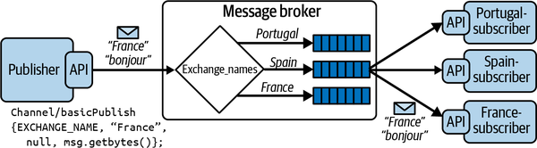
Example: RabbitMQ
RabbitMQ is one of the most widely utilized message brokers in distributed systems.
Producers send messages to exchanges
Exchanges distribute messages to queues based on exchange semantics
Consumer retrieve messages from queues
This Photo by Unknown Author is licensed under CC BY-SA
Notes:
In RabbitMQ, producers and consumers use a client API to send and receive messages from the broker.
The broker provides the store-and-forward functionality for messages, which are processed in a FIFO manner using queues.
The broker implements a messaging model based on a concept called exchanges, which provide a flexible mechanism for creating messaging topologies.
An exchange is an abstraction that receives messages from producers and delivers them to queues in the broker.
Producers only ever write messages to an exchange.
Messages contain a message payload and various attributes known as message metadata.
One element of this metadata is the routing key, which is a value used by the exchange to deliver messages to the intended queues.
Queues are bound to the exchange by consumers with three values, namely “France,” “Spain,” and “Portugal.” When a message arrives from a publisher, the exchange uses the attached routing key to deliver the message to one of the three attached queues

Slide 10
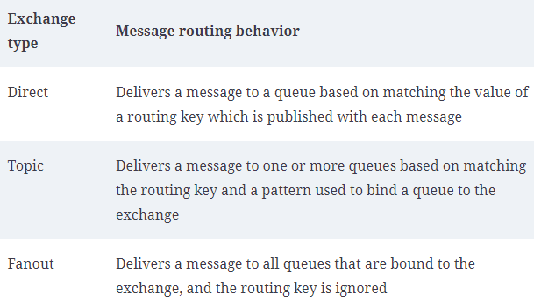
Example: RabbitMQ
Message Exchange Types

Slide 11
Example: RabbitMQ
Producer:
channel.exchangeDeclare(EXCHANGE_NAME, "direct");
channel.basicPublish(EXCHANGE_NAME, “France”, null,message.getBytes());
Consumer:
String queueName = channel.queueDeclare().getQueue();
channel.queueBind(queueName, EXCHANGE_NAME, “France”);
Notes:
The producer creates the exchange in the broker and publishes a message to the exchange with the routing key set to “France.”
A consumer creates an anonymous queue in the broker, binds the queue to the exchange created by the publisher, and specifies that messages published with the routing key “France'' should be delivered to this queue.

Slide 12
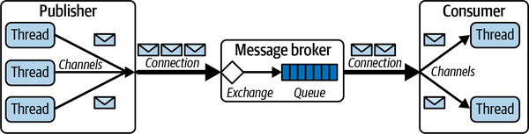
Example: RabbitMQ
Distribution & Concurrency
ConnectionFactory connFactory = new ConnectionFactory();
Connection rmqConn = connFactory.createConnection();
Channel channel = rmqConn.createChannel();
Notes:
Each RabbitMQ client connects to a broker using a RabbitMQ connection.
This is basically an abstraction on top of TCP/IP, and can be secured using user credentials or TLS.
Creating connections is a heavyweight operation, requiring multiple round trips between the client and server, and hence a single long-lived connection per client is the common usage pattern.
To send or receive messages, clients use the connection to create a RabbitMQ channel. Channels are a logical connection between a client and the broker, and only exist in the context of a RabbitMQ connection
Multiple channels can be created in the same client to establish multiple logical broker connections.
Creating a channel requires a network round trip to the broker. Hence for performance reasons, channels should ideally be long-lived, with channel churn, namely constantly creating and destroying channels, avoided.
To increase the throughput of RabbitMQ clients, a common strategy is to implement multithreaded producers and consumers. Channels, however, are not thread safe, meaning every thread requires exclusive access to a channel. This is not a concern if your client has long-lived, stateful threads and can create a channel per thread.

Slide 13
Example: RabbitMQ
Consumer Poll
Consumer Push
boolean autoAck = true;
GetResponse response = channel.basicGet(queueName, autoAck);
if (response == null) {
// No message available. Decide what to do …
} else {
// process message
}
boolean autoAck = true;
channel.basicConsume(queueName, autoAck, "tag", new DefaultConsumer(channel) {
@Override
public void handleDelivery(String consumerTag,
Envelope envelope,
AMQP.BasicProperties properties,
byte[] body)
throws IOException
{
// process the message
}});

Slide 14
Example: RabbitMQ
Runnable runnable = () -> {
try {
final Channel channel = connection.createChannel();
channel.queueDeclare(QUEUE_NAME, true, false, false, null);
// max one message per receiver
final DeliverCallback threadCallback = (consumerTag, delivery)
-> {
String message =
new String(delivery.getBody(), StandardCharsets.UTF_8);
// process the message
};
channel.basicConsume(QUEUE_NAME,
false, threadCallback, consumerTag -> {});
//
} catch (IOException e) {
logger.info(e.getMessage());
}
Multithreaded Consumers

Slide 15
Messaging Patterns Catalog
Catalog of ~65 patterns at Enterprise Integration Patterns
Comprehensive
Some of these important for scalability

Slide 16
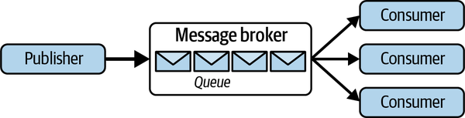
Messaging patterns
Competing Consumers Pattern
Advantages
Scalability: consumers can be increased or decreased on the fly.
Availability: If consumers are unresponsive/overloaded, the queue can still store messages
Guaranteed Delivery: At least once
Failover: If a consumer fails mid-task, the message is returned to the queue, to be picked up by another consumer.
Implications
Message Ordering – No Guarantee
Poison Messages - how do we handle malformed messages that cause crashes/exceptions
Idempotence - consumers must implement idempotent processing

Slide 17
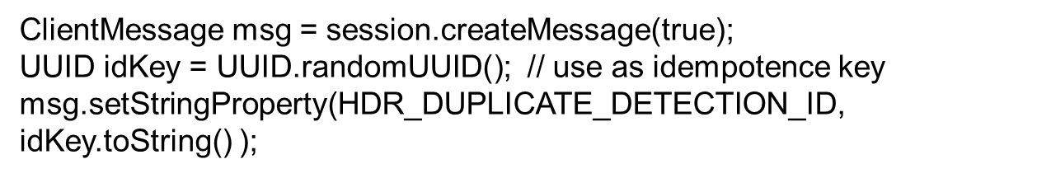
Messaging patterns
Exactly Once Processing
Retries need to be guarded against for idempotence
Producer
Consumer
On Publisher side:
Retries when publisher doesn’t acknowledge message
Can produce duplicates
Notes:
In asynchronous messaging systems, there are two sources for duplicate messages being processed.
The first is duplicates from the publisher,
and the second is consumers processing a message more than once.
Both need to be addressed to ensure exactly-once processing of every message.
The publisher part of the problem originates from a publisher retrying a message when it does not receive an acknowledgment from the message broker.
If the original message was received and the acknowledgment lost or delayed, this may lead to duplicates on the queue.
Fortunately, some message brokers provide support for this duplicate detection, and thus ensure duplicates do not get published to a queue.
Some message brokers allow using client-generated, unique idempotency key values for each message.
Publishers simply need to set a specific message property to a unique value, as shown in the following code:
The broker utilizes a cache to store idempotency key values and detect duplicates. This effectively eliminates duplicate messages from the queue, solving the first part of your problem.

Slide 18
Messaging patterns
Exactly Once Processing
On Consumer side:
Consumer fails during/aftermessage processing
Message delivered but not acknowledged
Broker redelivers message
Consumers must guard against duplicated
Broker hint – redelivered flag
Idempotence key
Notes:
On the consumer side, duplicates occur when the broker delivers a message to a consumer, which processes it and then fails to send an acknowledgment
The broker therefore redelivers the message, potentially to a different consumer if the application utilizes the competing consumer pattern.
It’s the obligation of consumers to guard against duplicate processing. By maintaining a cache or database of idempotency keys for messages that have been processed. Most brokers will set a message header that indicates if a message is a redelivery.
This can be used in the consumer implementation of idempotence. It doesn’t guarantee a consumer has seen the message already. It just tells you that the broker delivered it and the message remains unacknowledged.

Slide 19
Poison Messages
Corrupted messages, malicious content, programming bugs -> all may cause workers to fail
Poison messages
Workers continue to fail on redelivery
Poison Messages must be detected.
Solution
Limit redelivery count
When max reached, move to dead letter queue
Inspection
Remedial processing
Bug fix
Exact mechanism to handle poison messages differs by platform.
Notes:
For example, Amazon Simple Queue Service (SQS) defines a policy that specifies the dead-letter queue that is associated with an application-defined queue.
The policy also states after how many redeliveries a message should be automatically moved from the application queue to the dead-letter queue. This value is known as the maxReceiveCount.
In SQS, each message has a ReceiveCount attribute, which is incremented when a message is not successfully processed by a consumer.
When the ReceiveCount exceeds the defined maxReceiveCount value for a queue, SQS moves the message to the dead-letter queue.

Slide 20
Case Study

Slide 21
Questions?

